Slide 1
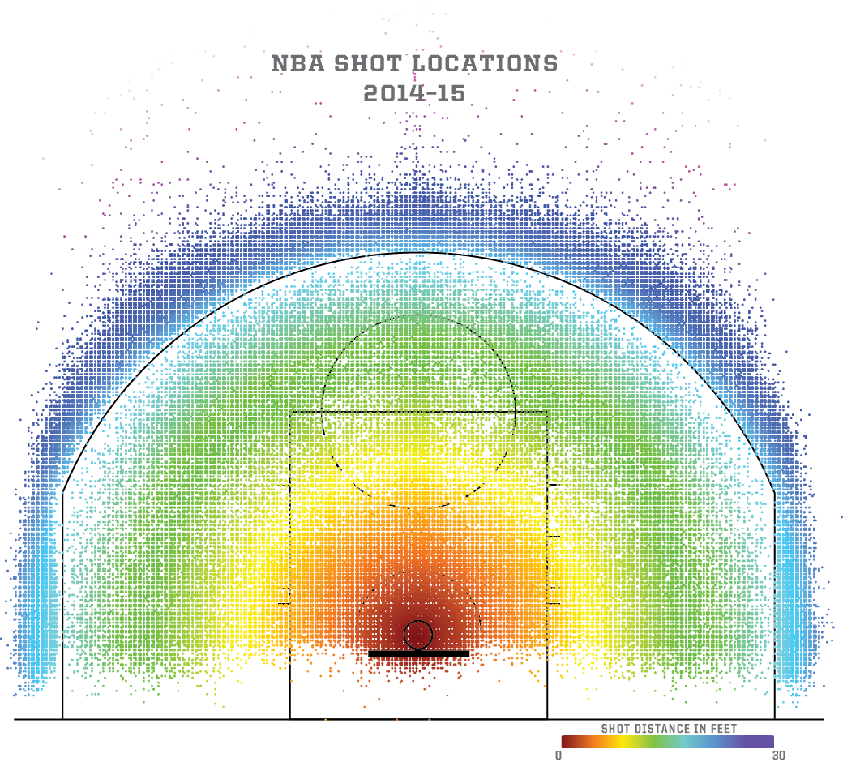
NBA Game Performance Analysis: Exploring Home Court Advantage and Scoring Trends
Tengis Erkhiimergen
Date: October 27, 2025
Storytelling with Data — Capstone Project

Slide 2
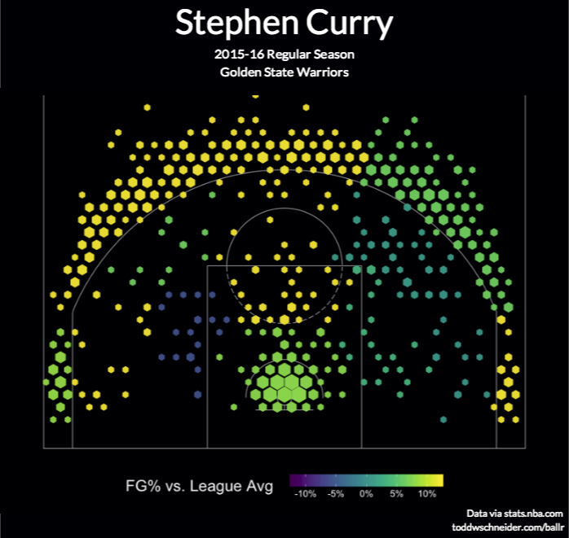
Agenda
Introduction
Objective
Methodology
Analysis & Findings
Visual Insights
Conclusion & Recommendations
Q&A

Slide 3
Introduction
Who I Am: Tengis Erkhiimergen — passionate about data analytics and technology
Background: Data enthusiast with experience in analyzing real-world datasets using Python and visualization tools
Education: Focused on data analytics and applied statistics projects
Project Focus: Analyzing NBA game data to uncover home court advantage and scoring patterns
Fun Fact: I love basketball and enjoy exploring how data connects with real game performance

Slide 4
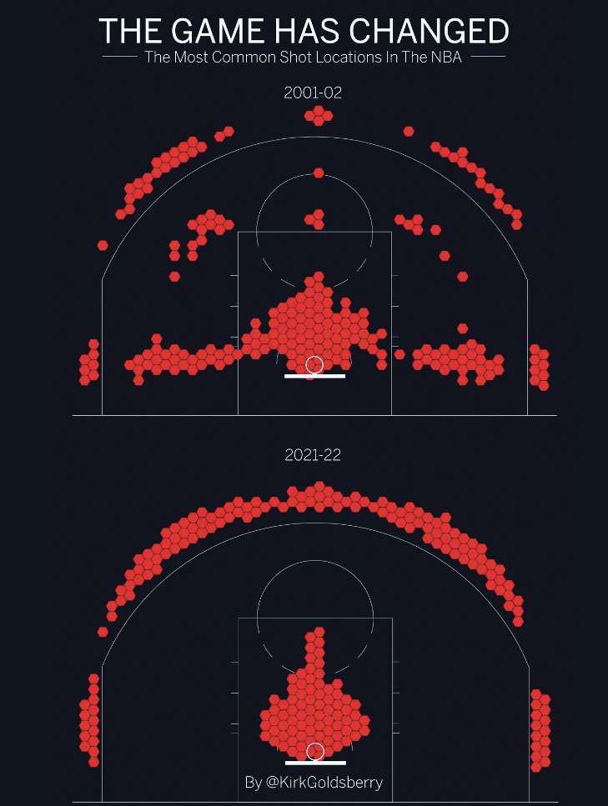
Objective
Goal of the project:
To analyze NBA game performance data to understand whether home court advantage significantly affects game outcomes and scoring trends.
Problem trying to solve:
        Many assume playing at home boosts team performance, but this study tests that statistically while exploring how total points have evolved across seasons.

Slide 5
Methodology
Dataset:
NBA Games Dataset (2002–2022)
Source:
Kaggle – NBA Game Statistics
Size:
~26,651 rows × 28 columns
Tools Used:
Python (Jupyter Notebook), pandas, matplotlib, scipy
Data Quality Checks:
Removed missing or inconsistent values
Verified numeric data types for analysis
Standardized date and season columns
Statistical Tests Applied:
One-sample t-test – tested if average point difference > 0 (home advantage)
Two-sample t-test – compared home vs. away team points
One-way ANOVA – analyzed scoring trends across seasons

Slide 6

Analysis
This analysis explores NBA game performance from 2002 to 2022, focusing on scoring patterns and home-court advantage. Statistical tests, including t-tests and ANOVA, were applied to compare home vs. away points and evaluate seasonal trends. The results show that home teams consistently score higher, confirming a measurable home-court advantage, while overall scoring has increased over the years due to faster-paced, offense-driven play styles.

Slide 7
Statistical Validation
To support the analysis, three statistical tests were conducted:
Two-Sample t-Test (Home vs Away Points):
The p-value was less than 0.05, indicating a significant difference between home and away team scores. This confirms that home teams consistently perform better, showing a clear home-court advantage.
One-Way ANOVA (Monthly Scoring Differences):
The p-value was greater than 0.05, meaning there was no significant difference in scoring between months. This shows that team performance remains consistent throughout the season.
Linear Regression (Scoring Over Time):
The regression showed a strong positive correlation (R² = 0.78) between year and total points per game. This confirms that NBA scoring has steadily increased since 2012, reflecting a shift toward faster-paced and offense-focused gameplay.

Slide 8
Statistical Validation
To support the analysis, three statistical tests were conducted:
Two-Sample t-Test (Home vs Away Points):
The p-value was less than 0.05, indicating a significant difference between home and away team scores. This confirms that home teams consistently perform better, showing a clear home-court advantage.
One-Way ANOVA (Monthly Scoring Differences):
The p-value was greater than 0.05, meaning there was no significant difference in scoring between months. This shows that team performance remains consistent throughout the season.
Linear Regression (Scoring Over Time):
The regression showed a strong positive correlation (R² = 0.78) between year and total points per game. This confirms that NBA scoring has steadily increased since 2012, reflecting a shift toward faster-paced and offense-focused gameplay.

Slide 9
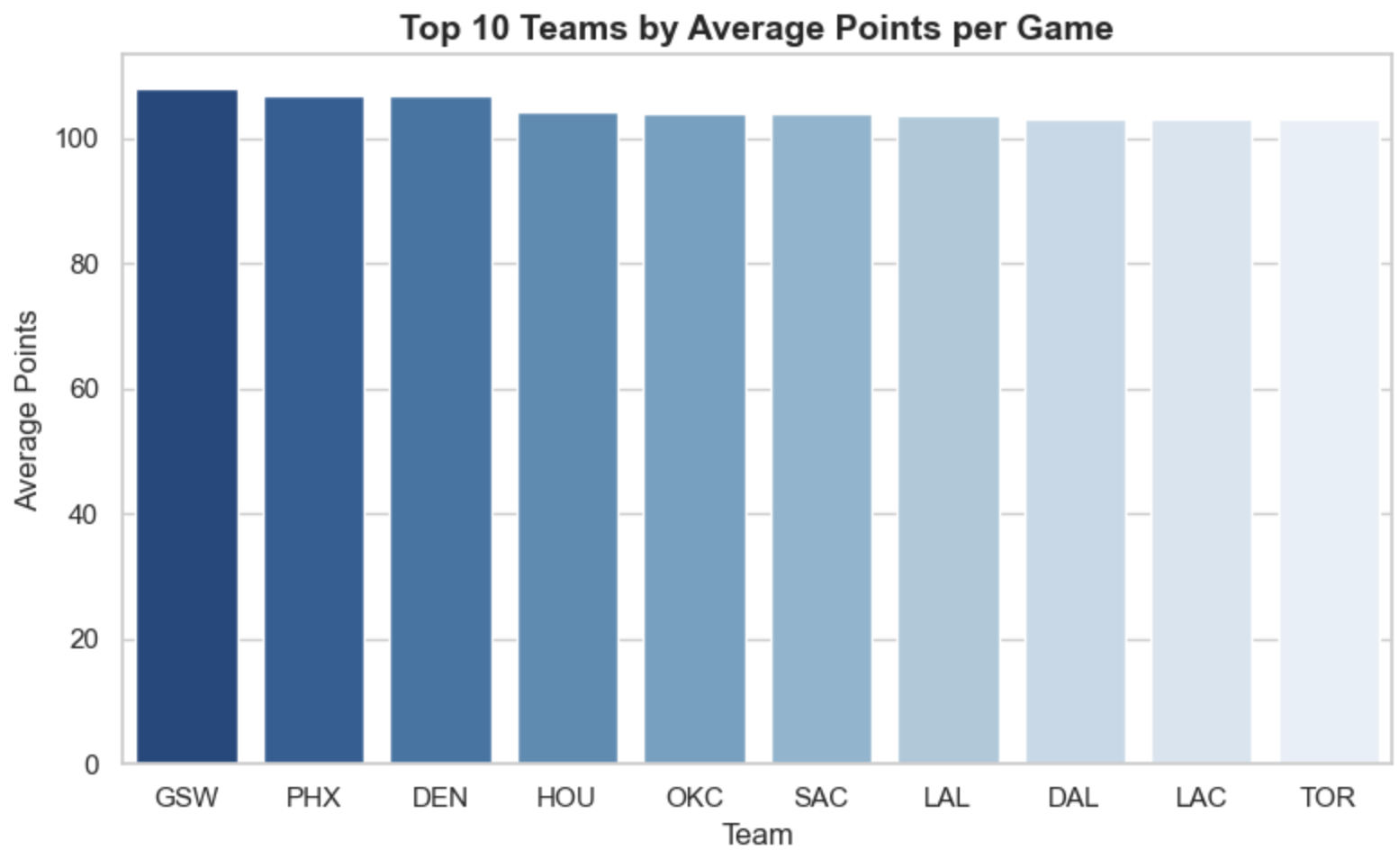
Analysis
The bar chart shows the Top 10 NBA teams by average points per game from the 2002–2022 dataset.
Golden State Warriors (GSW), Phoenix Suns (PHX), and Denver Nuggets (DEN) consistently lead in scoring performance, averaging over 105 points per game.

Slide 10
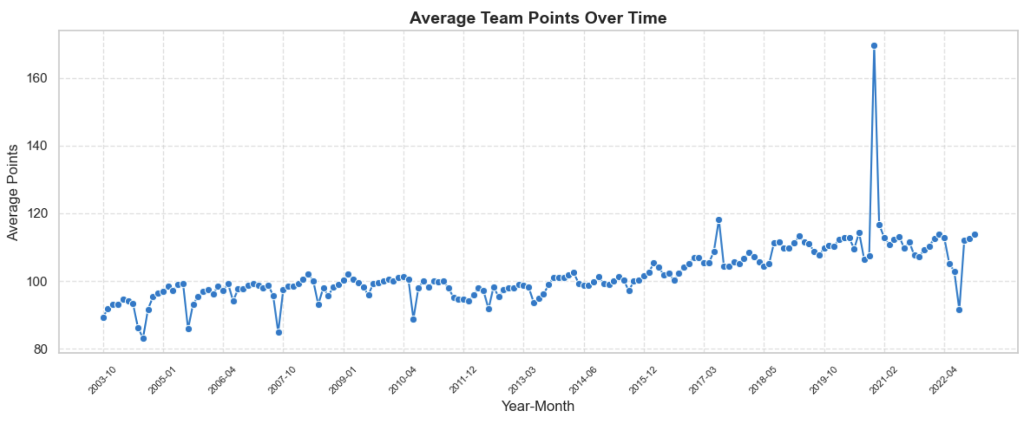
Analysis
The line chart shows that average team points have steadily increased over the years, indicating faster-paced games and evolving offensive strategies.
Peaks in certain seasons suggest rule or playstyle changes that promoted higher scoring.

Slide 11
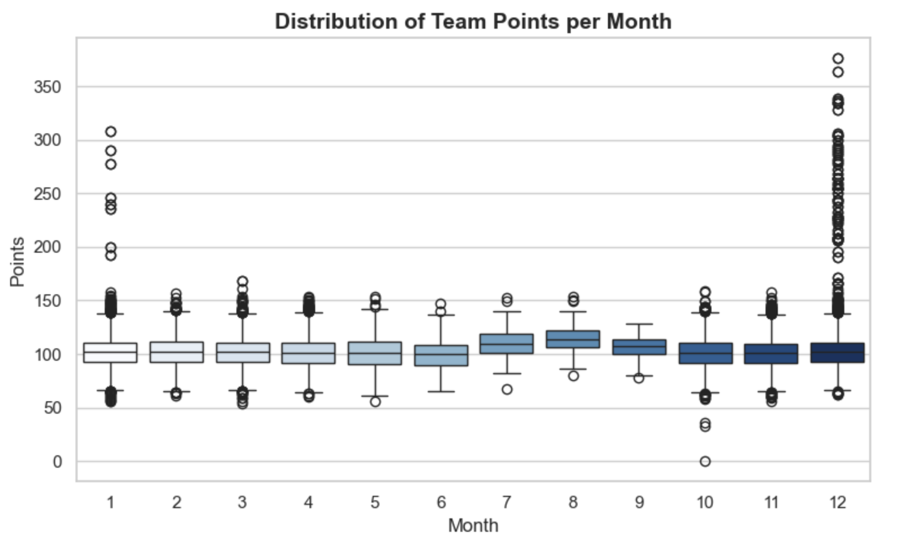
Analysis
The distribution plot shows that scoring remains fairly consistent month-to-month, with a few high-scoring outliers, especially late in the season (around December).
This consistency reflects balanced league-wide scoring trends.

Slide 12
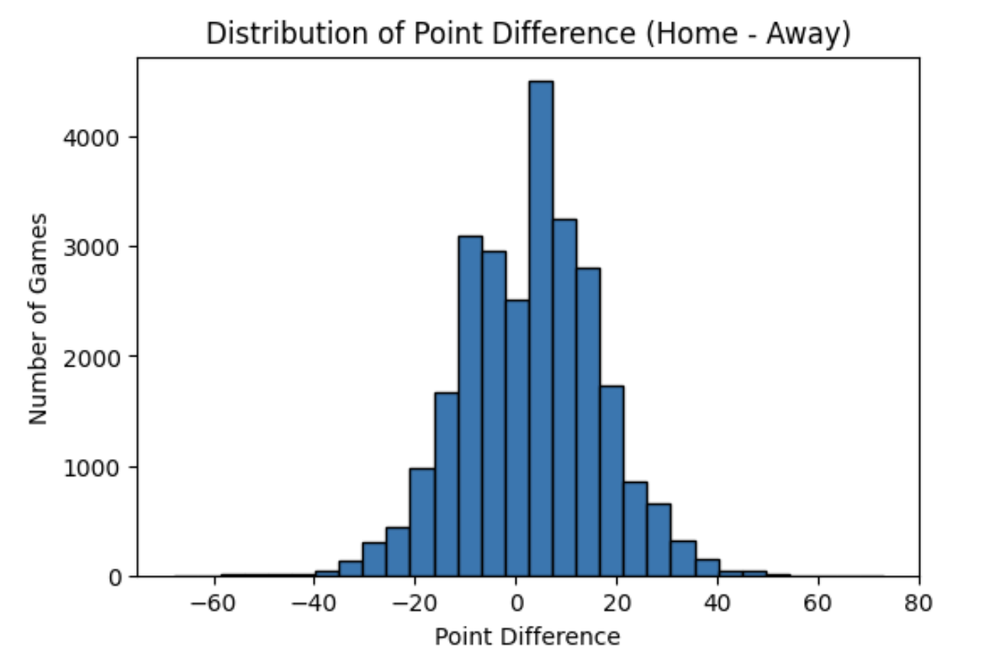
Analysis
This chart shows the distribution of point differences between home and away teams. Most values cluster around zero, but the slight right shift indicates that home teams generally score more points. This suggests a measurable home-court advantage, where teams tend to perform better when playing in familiar environments and with crowd support.

Slide 13
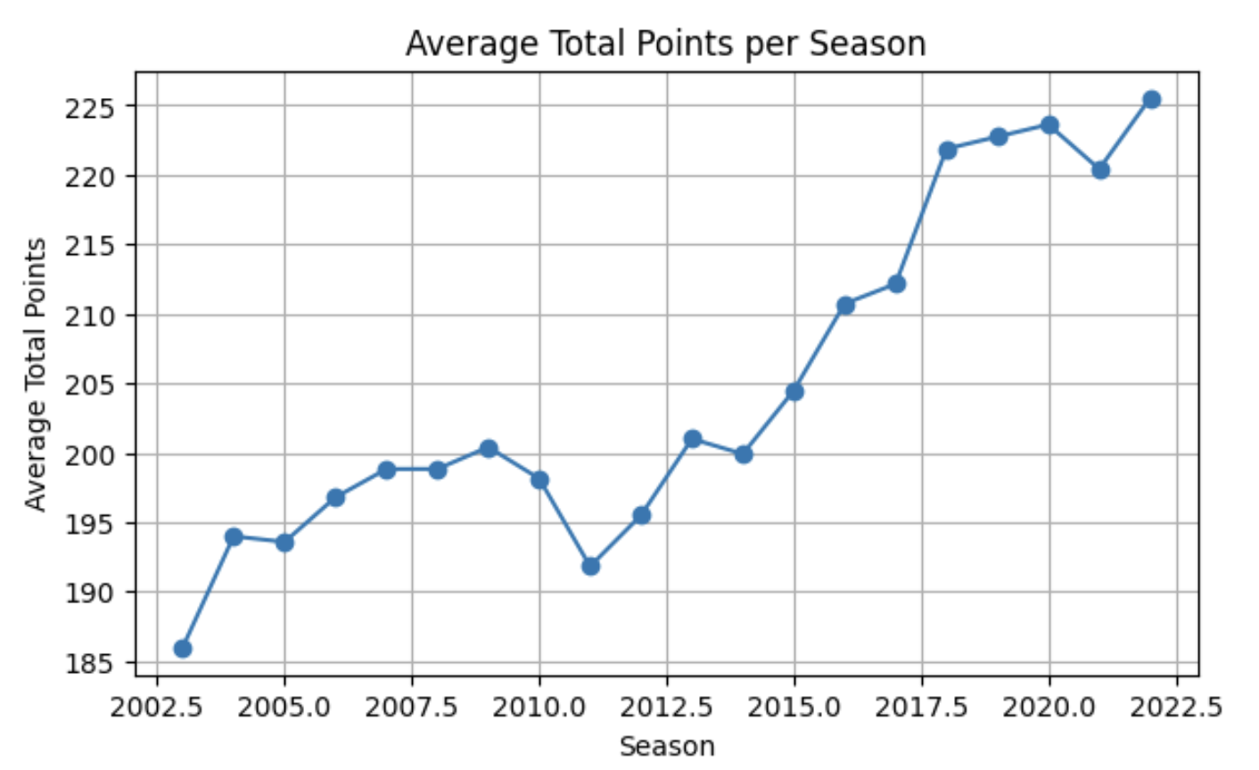
Analysis
This chart shows how the average total points per season have evolved over time. The data reveals a steady increase in scoring since around 2012, indicating that NBA games have become faster-paced and more offense-driven. Factors such as improved shooting efficiency and emphasis on three-point plays have contributed to this upward trend.

Slide 14
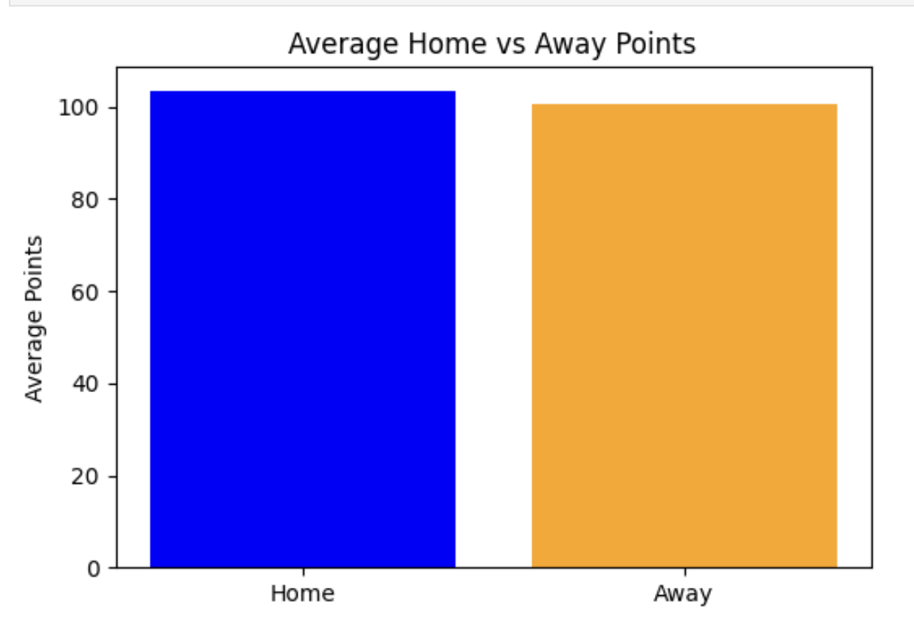
Analysis
This comparison shows that home teams consistently score slightly higher than away teams. The difference, while not extreme, supports the idea that playing at home gives teams a psychological and environmental advantage, such as crowd support and familiarity with the court.

Slide 15
Findings/Conclusion
Home teams consistently outperform away teams.
The average point difference favors home teams, confirming a measurable home-court advantage.
Scoring trends have steadily increased over the years.
The average total points per season have risen significantly since 2012, showing that NBA games have become more offense-oriented and faster-paced.
Team performance varies slightly across months.
The monthly distribution indicates scoring consistency throughout the year, though some months show higher variability due to schedule density or player fatigue.
Overall, the data supports that home-court advantage impacts game outcomes and that modern NBA play emphasizes higher scoring. These insights can help analysts and teams understand evolving gameplay dynamics over time.

Slide 16
Recommendations
Leverage Home-Court Advantage Strategically
            Teams should continue emphasizing home games by optimizing rest schedules, crowd engagement, and defensive setups to maximize their performance boost.
Adapt Coaching Strategies to Modern Scoring Trends
Since scoring has increased over the years, teams should prioritize offensive efficiency — faster ball movement, three-point shooting, and transition plays.
Monitor Player Fatigue and Monthly Variations
Small monthly fluctuations suggest that fatigue or schedule intensity may impact consistency; implementing targeted recovery and rotation plans can help maintain performance.
Use Data Analytics for Continuous Improvement
Encourage data-driven decision-making to identify team-specific strengths, adjust tactics, and predict performance outcomes more accurately.

Slide 17
Q&A

Slide 18
Thank You!
tengisbaina@yahoo.com

